Slide 1

Hyper-local weather dashboard using The Weather company's API on IBM Cloud.
PRESENTED BY :- RUPAL RAJ
IBM Hack Challenge 2020
Application ID: SPS_CH_APL_20200006618
Project ID:SPS_PRO_1722
Team: ARTHUR

Slide 2
AGENDA
Connect your PWS to Weather Underground (WU) and view PWS data on WU
Learn about Node-RED (local and on IBM Cloud)
Explore the node-red-contrib-twc-weather Node-RED PWS node
Import / Deploy the Weather Dashboard example
Display PWS data in your Weather Dashboard

Slide 3
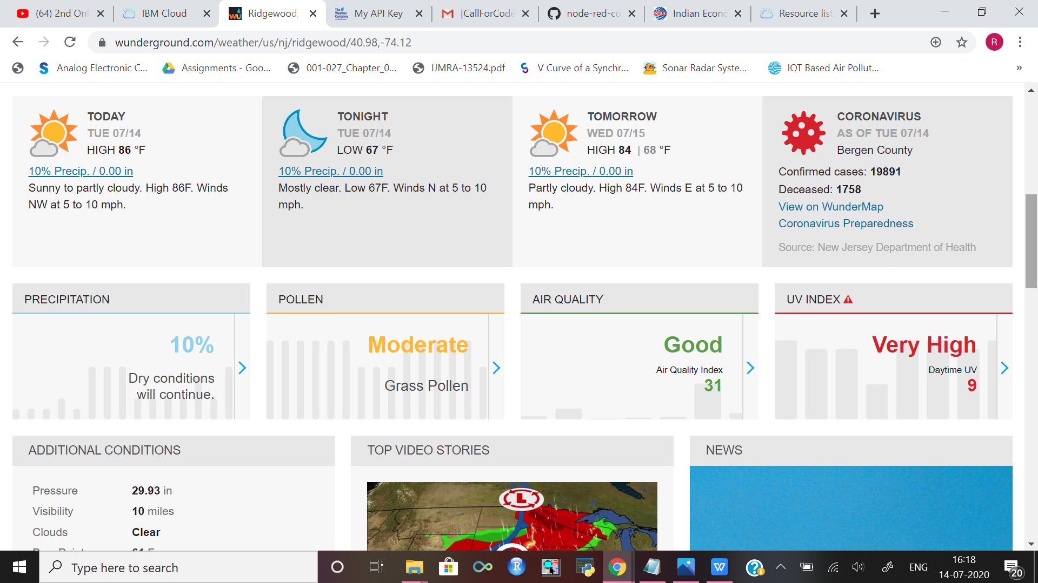
PWS network
there are about 12k government provided wather stations.
Weather Underground, a part of The Weather Company, an IBM Business, encourages members to register their PWS and send data to http://www.wunderground.com

Slide 4
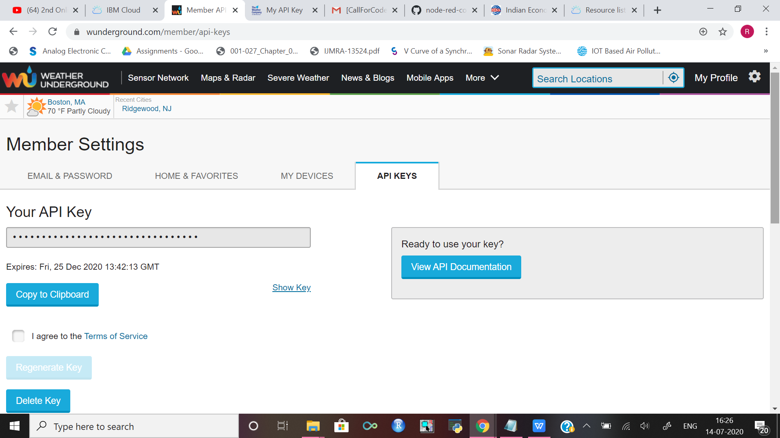
make your own API

Slide 5
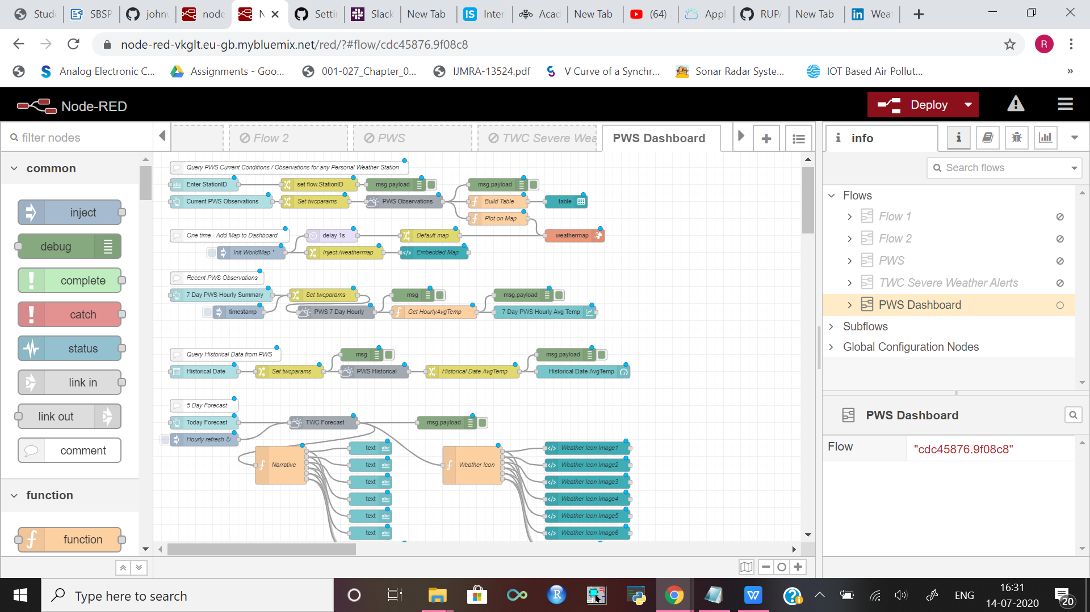
NODE RED on IBM CLOUD

Slide 6
This project gave you some basic working knowledge of the IBM Cloud Service and shows how to use it along with JavaScript and Node Red to build your own Hyper-Local Weather Dashboard .
This project also tells about the integration process of PWS with the Watson services to access and create your weather dashboard.

Slide 7
Now that the Node-RED node-red-contrib-twc-weather nodes are able to query weather data
It provides a browser-based editor that makes it easy to wire together flows using the wide range of nodes in the palette that can be deployed to its runtime in a single-click.
node-red-contrib-twc-weather
node-red-dashboard
node-red-node-ui-table
node-red-contrib-web-worldmap

Slide 8
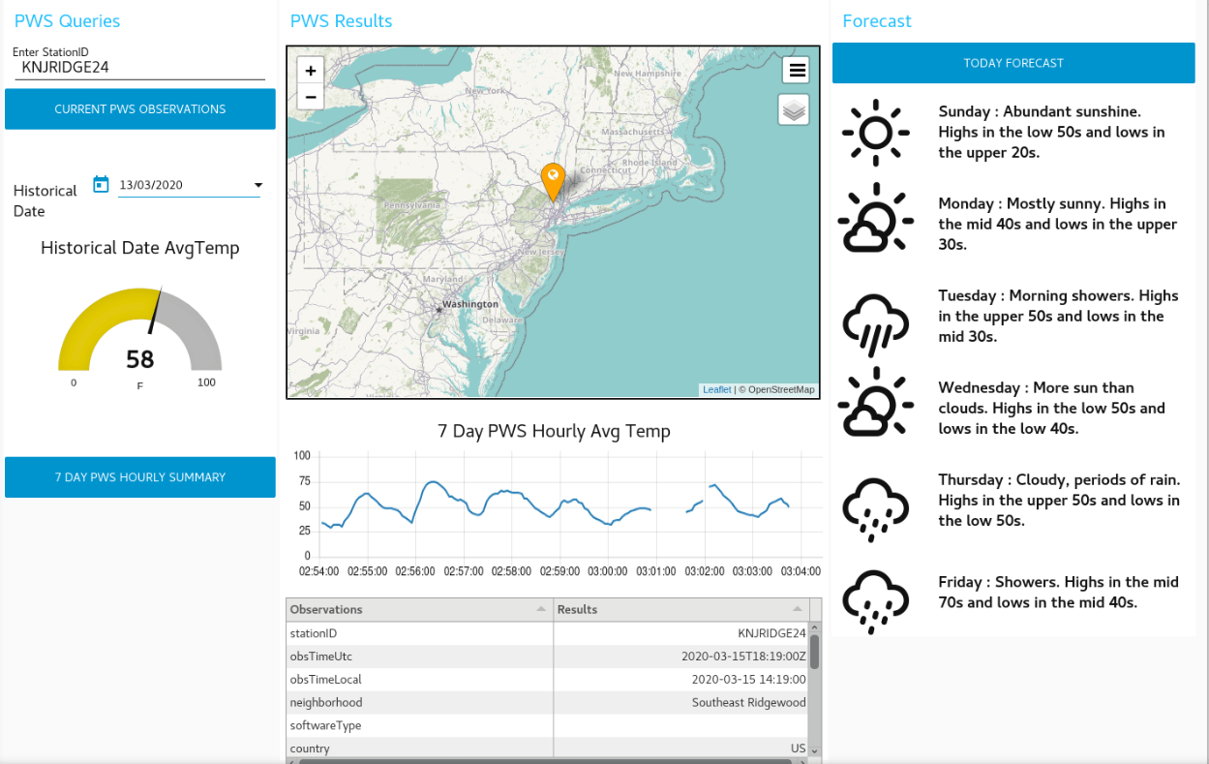
Display PWS Data In Your Weather Dashboard

Slide 9
CONCLUSION
This project gave you some basic working knowledge of the IBM Cloud Service and shows how to use it along with JavaScript and Node Red to build your own Hyper-Local Weather Dashboard . This project also tells about the integration process of PWS with the Watson services to access and create your weather dashboard.

Slide 10
THANK YOU Name: RUPAL RAJ College Name: KALINGA INSTITUTE OF INDUSTRIAL TECHNOLOGY.

